Slide 1
Google Data Analytics : Case Study : How Does A Bike –Share Navigate Speedy Success?( How do annual member and casual riders use Cyclistic bikes differently)
By :Harish Sreenivasan
Updated on :01/03/2023

Slide 2
INDEX
Overview
Objective
Data C leaning and Manipulation
Total Rides taken in a year
Random sample :Ride taken in a week in Jan 2023
Random sample : Average Ride length per month in January 2023
Observations
Recommendations
Q & A session

Slide 3
Overview
In 2016, Cyclitic launched a successful bike-share offering. Since then, the program has grown to a fleet of 5,824 bicycles that are geo-tracked and locked into a network of 692 stations across Chicago. The bikes can be unlocked from one station and returned to any other station in the system anytime.
Cyclitic sets itself apart by also offering reclining bikes, hand tricycles, and cargo bikes, making bike-share more inclusive to people with disabilities and riders who can’t use a standard two-wheeled bike. The pricing plans offered are: Single-ride passes, full-day passes, and annual memberships, wherein single –ride or full-day ride passes are referred to as casual riders and the ones with annual memberships are Cylistic members .

Slide 4
Objective
Compare how different are annual riders to casual riders
How to market a strategy to convince the casual riders to move to annual membership
Data Source : It a indigenous data, accessible through :-
https://divvy-tripdata.s3.amazonaws.com/index.html
The data has been made available by Motivate International Inc. under the license :- https://www.divvybikes.com/data-license-agreement
Data under analysis is for a period of one year ranging form February 2022 up till January 2023.
Tools used for Analysis : Microsoft Excel, RStudio and Microsoft PowerPoint.

Slide 5
Data Cleaning & Manipulation
The data was cleaned and manipulated in Microsoft Excel.
Formatting changes were made to form constituency within the files,.
Two new columns were added in the each of the 12 excel file for determining ride length and the day of the week.
Further analysis was conducted based on the Rscript provided within the worksheet using the csv files form the original data source with Rstudio.
The 12 dataset files were combined into a single file with 9 variable observations with count of :- 5754248.

Slide 6
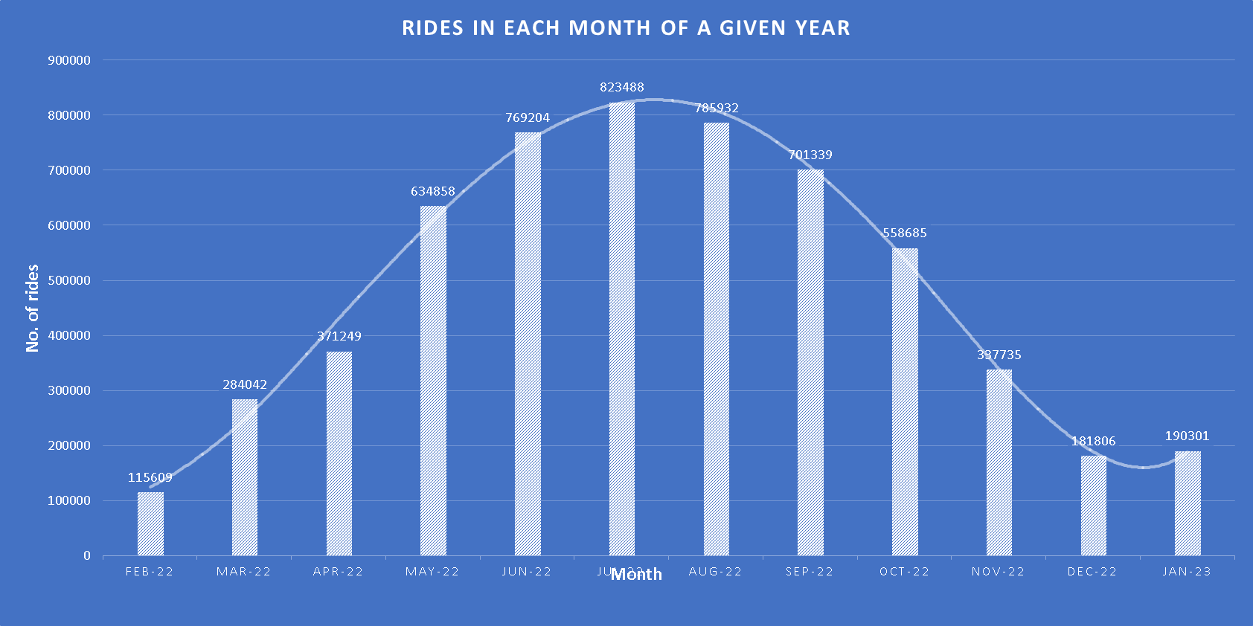
Total Rides taken in a year

Slide 7
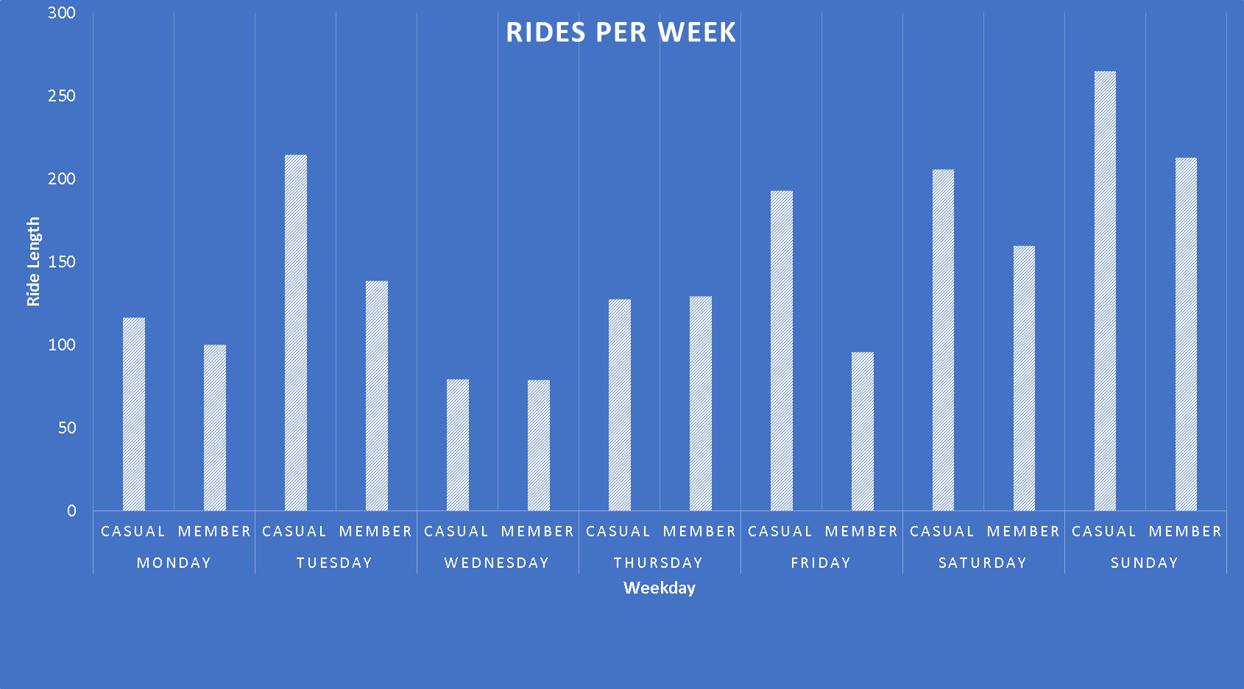
Random sample :Ride taken in a week in Jan 2023

Slide 8
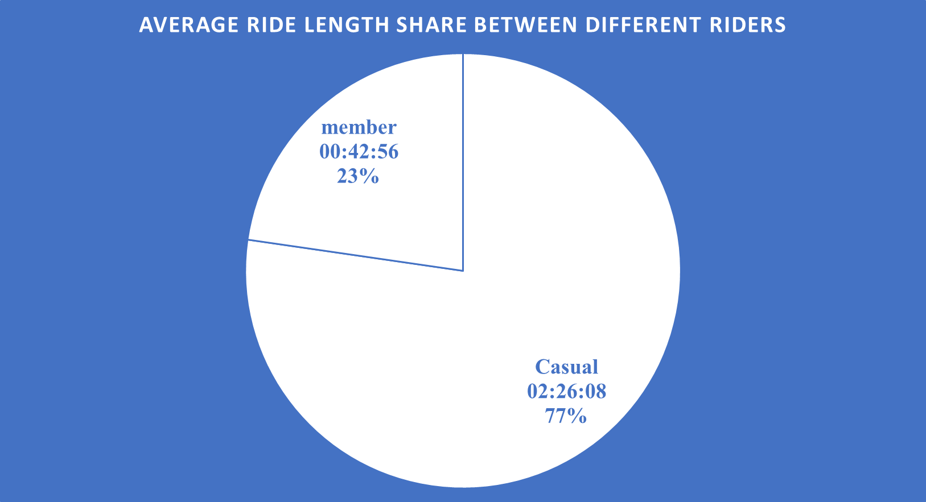
Random sample : Average Ride length per month in January 2023

Slide 9
Observations
The number of casual as well as member riders through out the week is similar.
The usage of casual riders increases during the weekends :- Saturday and Sunday.
The dataset at hand has its limitations namely missing values, black spaces , which the through analysis compromised
The frequency of rides decreases in the month of December, January and February because of winters.

Slide 10
Recommendations
A new annual pass exclusive to week should be issued to attract the casual riders.
If added benefits such as exclusive access to the ride can attract casual riders.
A reward system for the higher number of kilometers covered with Cyclistic, will thus help grab attention.

Slide 11
Any Questions

Slide 12
Thank you

